Slide 1
What is social communication and information communication
什么是社会交际与信息沟通
Completed by：
Wei Feng
Xu Lulu

Slide 2
social communication
The structure of interpersonal relationship refers to the elements of interpersonal relationship and their mutual relationship. In reality, the elements that constitute or influence interpersonal relationship can be divided into dominant elements and recessive elements. Dominant elements refer to the external elements of interpersonal relationship, including communication subject, communication object, communication means, communication environment, communication purpose, communication process, communication content, etc. Hidden elements refer to the internal factors that affect interpersonal relationships, including interests, emotions, dignity and so on.
人际关系的结构是指构成人际关系的要素及其相互关系。在现实中，构成或影响人际关系的要素又可以区分为显性要素和隐性要素。显性要素是指构成人际关系的外在要素，包括交往主体、交往对象、交往手段、交往环境、交往目的、交往过程、交往内容等。隐性要素是指影响人际关系的内在因素，包括利益、情感、尊严等。
一、The dominant elements of interpersonal relationship in social communication
构成社会交际中人际关系的显性要素
(一)Subject and object of communication交往主体和交往对象
1．Communication subject交往主体
2．Contacts交往对象

Slide 3
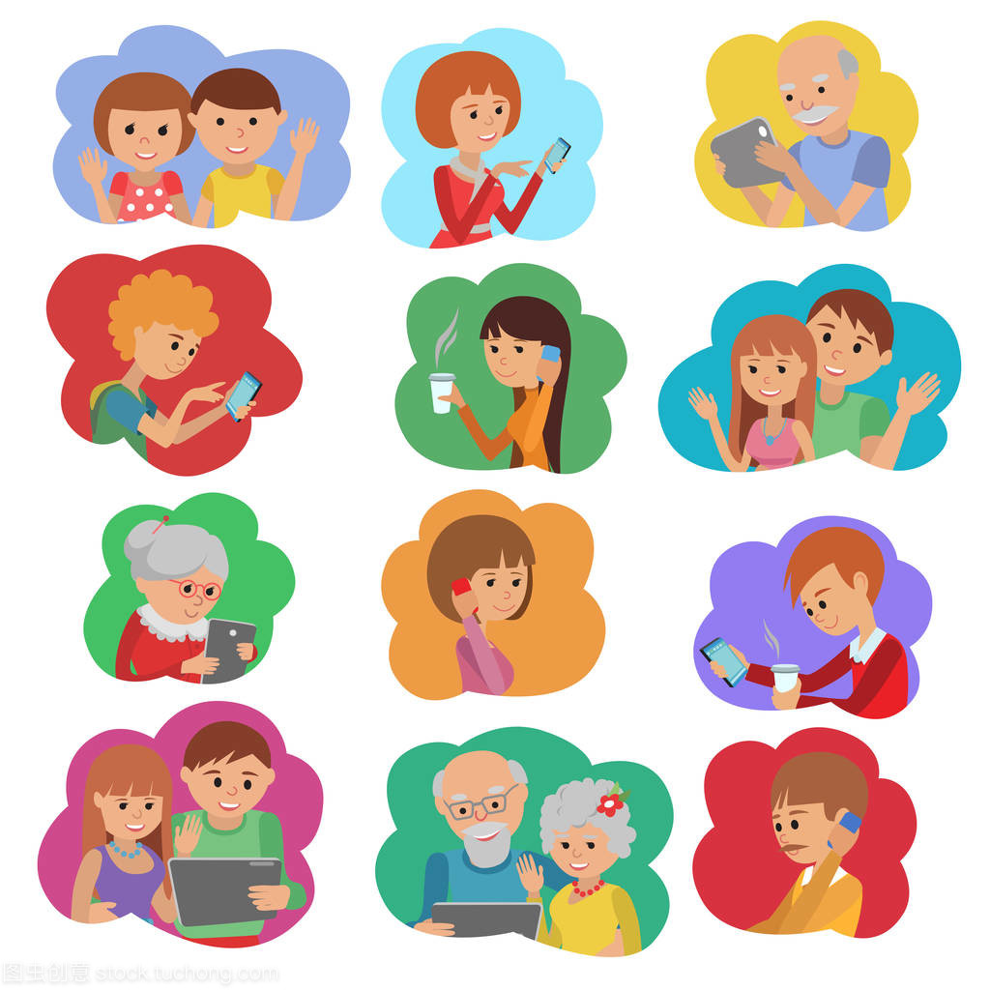
(二)Means of communication交往手段
Generally speaking, the means of communication can be divided into language means and material means
一般说来，交往的手段可分为语言手段和物质手段两类。
1．Language means
语言手段
(1)Voice language
有声语言。
(2)written language
书面语言。
(3)Body language
体态语言。

Slide 4
2.Material means物质手段
First, the means of communication determine the results of communication
第一，交往手段决定着交往结果
Material means are all kinds of valuable materials used for interpersonal communication. Such as money, tobacco and alcohol, specialty, utensils, cultural relics, etc. In order to achieve the purpose of communication, we must use certain means of communication. However, the following two points need to be made clear in the use of communication means:
物质手段是指用以进行人际交往的各种具有价值的物质。如金钱、烟酒、特产、器具、文物等。 为了实现交往目的，必须运用一定的交往手段。但在运用交往手段的问题上需要明确以下两点：
Second, the means of communication determine the nature of communication.
第二，交往手段决定着交往性质。

Slide 5
（三） Communication environmen交往环境
Communication environment includes communication condition and communication situation
交往环境包括交往条件和交往情境两个方面。
1．Communication conditions
交往条件
2．Communication situation
交往情境
The purpose of communication refers to the goal that the participants achieve through communication.交往目的是指通过交往使参与者达到的目标。
The purpose of communication determines the development direction of the whole communication process.交往目的决定着整个交往过程的发展方向。

Slide 6
(四)Purpose of communication
交往目的
The purpose of communication refers to the goal that the participants achieve through communication.交往目的是指通过交往使参与者达到的目标。
The purpose of communication determines the development direction of the whole communication process.交往目的决定着整个交往过程的发展方向。

Slide 7
1．Single line communication单线式交往
（五)Communication
process
交往过程
2．Multi line communication多线式交往
The so-called information exchange means that people pass information to each other in the process of interpersonal communication,And accept the other party's information feedback behavior.
所谓信息交流是指人们在人际交往过程中向对方传递信息，
并接受对方的信息反馈的行为。
(六)Communication
content
交往内容

Slide 8
（七）Communicative function 交际作用
One is to improve individual productivity and promote the creation, maintenance, dissemination and development of social productivity; 一是提高个体生产力，促进社会生产力的创造、保持、传播和发展；
Second, the necessary conditions for the emergence, deepening and development of cognition; 二是认识产生、深化和发展的必要条件；
Third, it can promote the all-round development of animals 三是能够促进动物的全面发展。

Slide 9
二、Information communication
（一）The functions of communication for school management include: information transmission, emotional communication and control.
沟通对于学校管理所具有的功能包括:信息传递、情感交流、控制功能。
（二）Basic model
The basic structure of communication includes three aspects: information, feedback and channel. According to the specific structure, communication can be divided into informal communication network and formal communication network.
沟通的基本结构包括信息、反馈、通道三个方面，缺少任何一方都完不成沟通。沟通按具体结构划分可分为非正式沟通网络与正式沟通网络两种。
Communication is classified according to the direction of information flow：
According to the direction of information flow, communication can be divided into upward communication, parallel communication and downward communication
沟通按信息流动方向分类
沟通按信息流动方向分类可分为上行沟通、平行沟通和下行沟通

Slide 10
Thank you for listening

